Slide 1
Javascript Dashboard Elements – Part 1
Dr Simon Lock
simon.lock@bristol.ac.uk

Slide 2
Overview
Many of you are building web pages or web apps
May involve some fancy Javascript components
Typically done badly in the past !
Main focus is on Javascript dashboard elements
Aim is to make sure you know of these elements
And give you some initial confidence in using them
This is a fair bit of material – it will take 2 lectures !

Slide 3
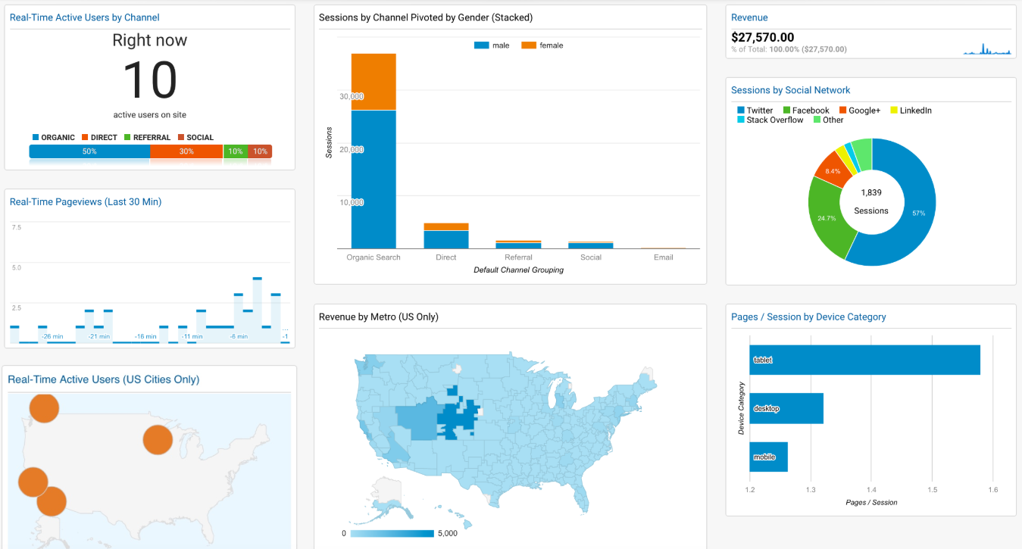
Classic example: Web Analytics Dash

Slide 4
Elements we will cover
Google Maps
Static Street View
Graphing and Charting
Raw Canvas Elements
Note: We won’t go into detail on all of the features
This is just a basic “getting you started” guide

Slide 5
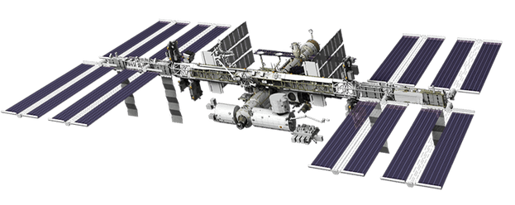
Google Maps
You all must have used Google Maps in the past
But you might not have used the Google Maps API
Let’s build a “simple” mapping application…
Does anybody know what this is:

Slide 6
Getting an API key
Before we can use Google Maps API
We need to register for an API key:
https://developers.google.com/maps/
documentation/javascript/get-api-key
This is so Google can keep track of your usage
The number of page loads is also limited
At some point they’d like you to pay to use it !

Slide 7
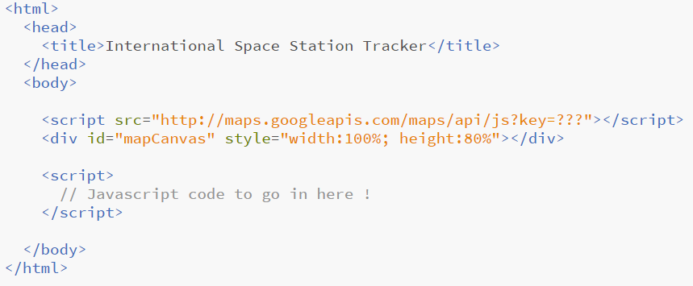
Basic HTML page
Your API key

Slide 8
This is what it looks like…

Slide 9
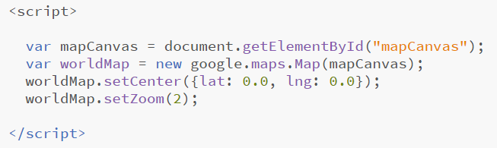
Let’s set up the map

Slide 10
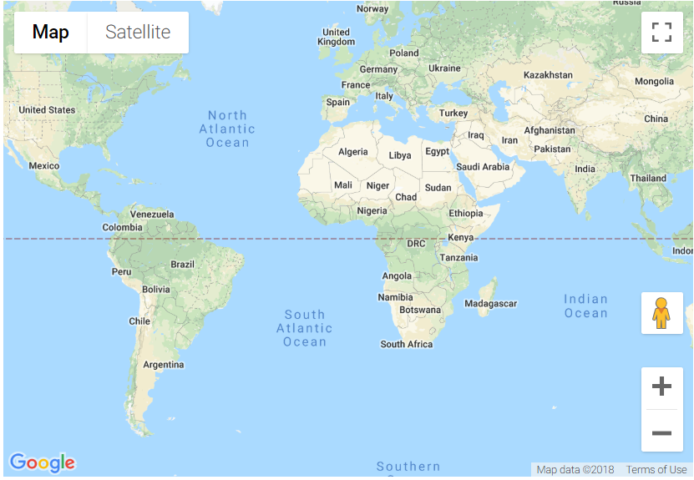
This is what it looks like…

Slide 11
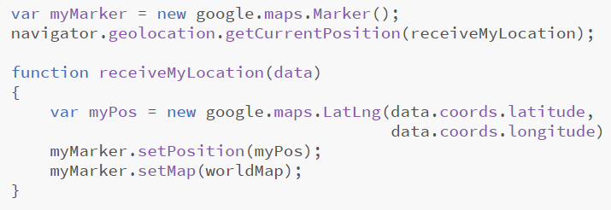
Let’s add a marker for us

Slide 12
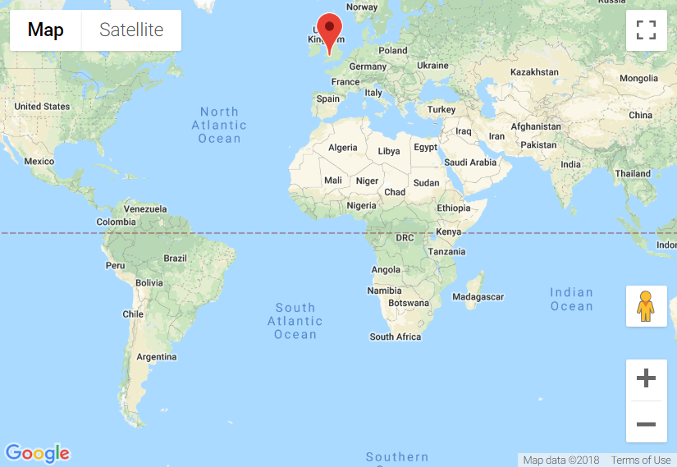
This is what it looks like…

Slide 13
Let’s add a marker for ISS
But where IS the space station ???
http://api.open-notify.org/iss-now.json
Numbers change quickly !
Because it’s travelling at 17150 mph

Slide 14
How do we “call” this from Javascript ?
Could do it with jQuery (if you know it)
But instead let’s go back to basics
No code inside the tag !
No SRC attribute to load in a script !!
What kind of magic is this ???

Slide 15
The Magic
Inside our main script section, we need to dynamically set the SRC of this empty tag !
Let’s set it to:
http://api.open-notify.org/iss-now.json?callback=receiveStationLocation

Slide 16
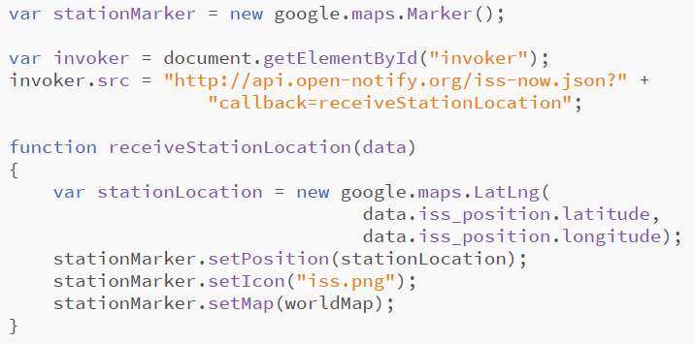
The Code

Slide 17
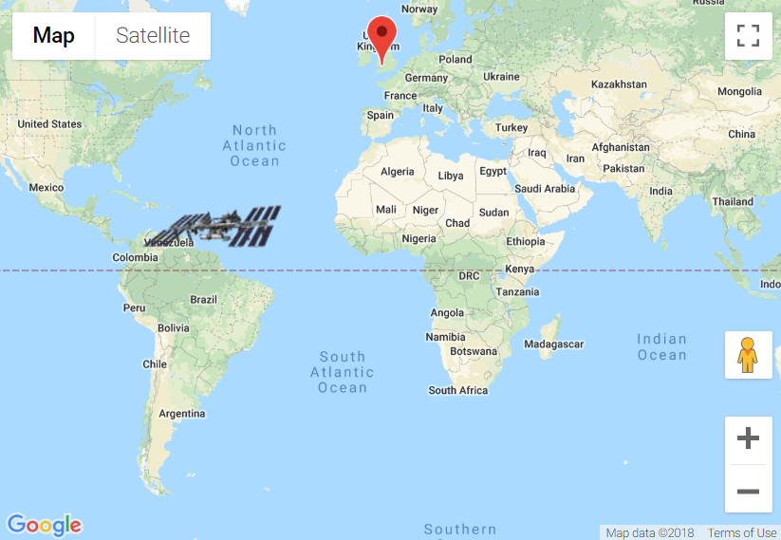
This is what it looks like…

Slide 18
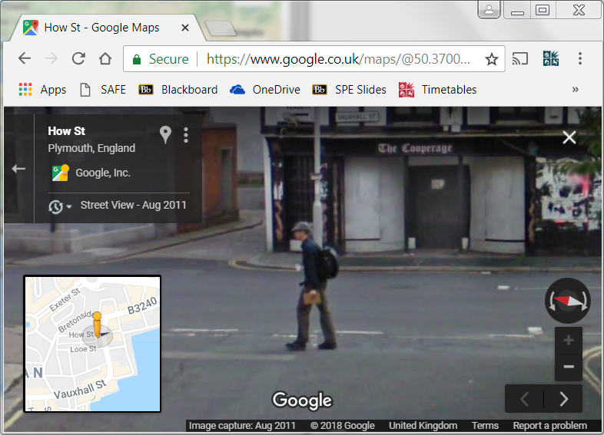

Slide 19
Google Street View
You’ve all used google street view before
Did you know that there is a “Static” API ?
One that we can use to get JPG images ?
Used to be totally free and unlimited
But now you need to register :o(
You get 1 free image load per day (use it wisely)

Slide 20
Google Street View Parameters
API key
Image size
Field-of-view
Pitch (up / down)
GPS location
Compass bearing
http://maps.googleapis.com/maps/api/streetview?key=xxxxxxxxxxxxxx&size=640x400&fov=90&pitch=10&location=51.456207,-2.602716&heading=220

Slide 21
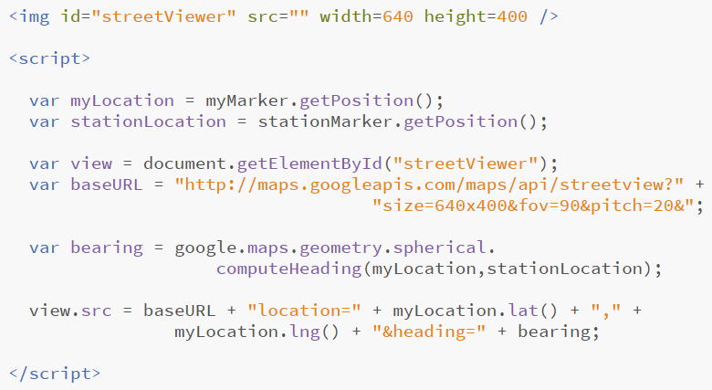
Which way to look ?

Slide 22
Live Demo !!! O:\Desktop\Data Tutorials\solutions\ISS Now (GoogleMaps & JSON)\GoogleMaps.html

Slide 23
Word of warning
Google have recently started charging for maps
You get some free traffic to start with
But if your project is to be rolled out to the public
You might like to discuss costs with your client !
There are various free alternatives to google maps
OpenStreetMaps / OpenLayers is just one of them
The concepts are very similar to Google Maps…

Slide 24
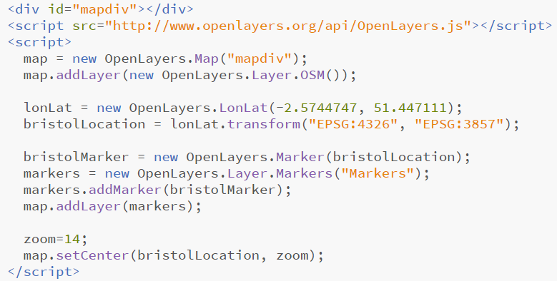
OpenLayers and OSM

Slide 25
